Slide 1

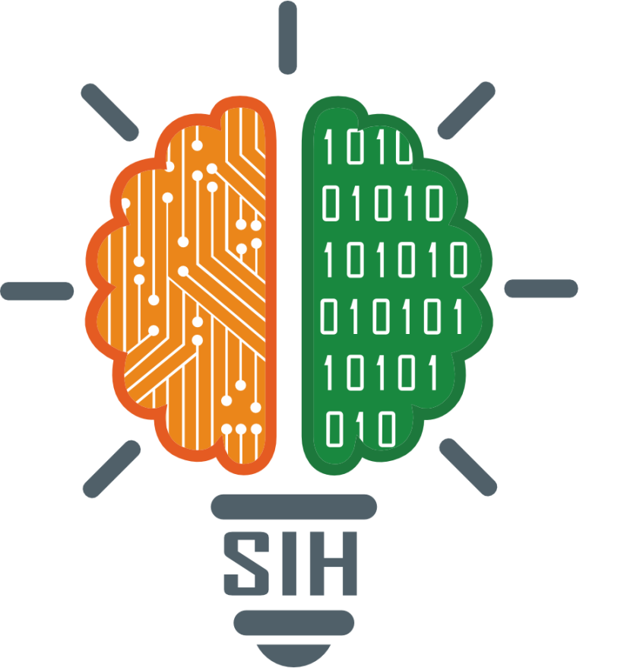
SMART INDIA HACKATHON 2025
BusKr
Real-Time Bus Tracker App
Problem Statement ID: SIH25013
Problem Statement Title: Government of Punjab - Real-Time Public Transport Tracking for Small Cities
Category: Transportation & Logistics Real-Time Bus Tracker App
Theme: Transportation and Logistics
PS Category: Software
Team Name: BusKr

Slide 2
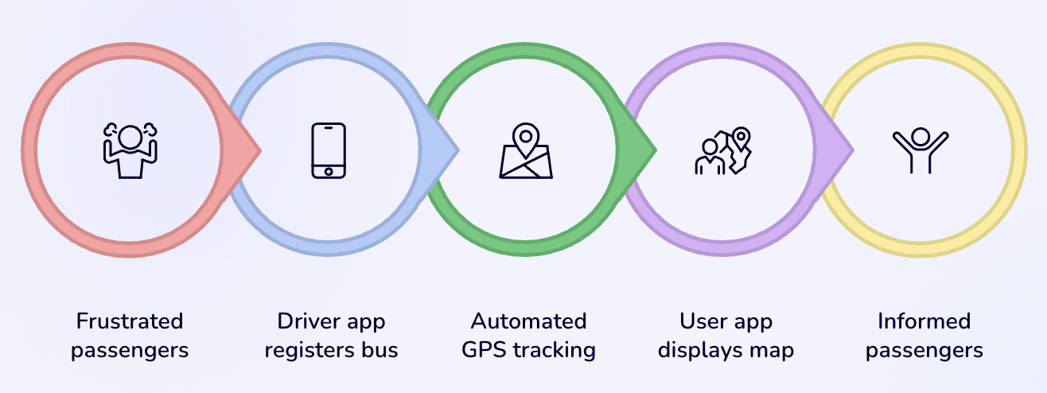
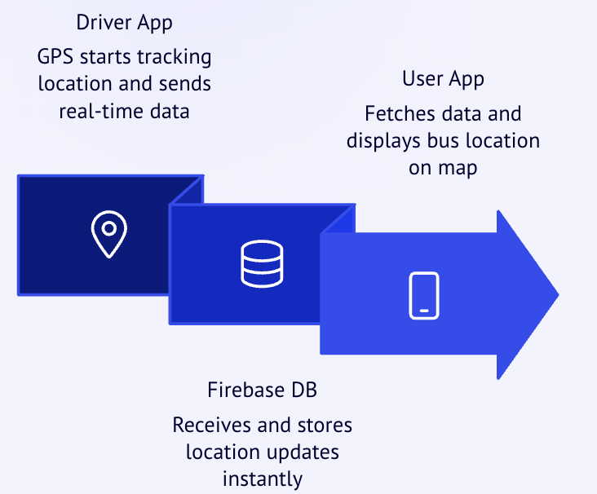
Real-Time Bus Tracker App
BusKr
Passengers face uncertainty with no visibility into bus arrivals, leading to frustration and reduced public transport usage. In Tier-2 and Tier-3 Indian cities, over 60% of bus commuters face delays of more than 15-30 minutes. (NITI Aayog)
Our Solution: Twin-App Ecosystem
Driver Application
Simple bus number registration
Automated GPS location tracking
Real-time data transmission
User Application
Interactive Google Maps integration
Live bus location visualisation
Delivering comprehensive journey planning with real-time tracking capabilities.

Slide 3
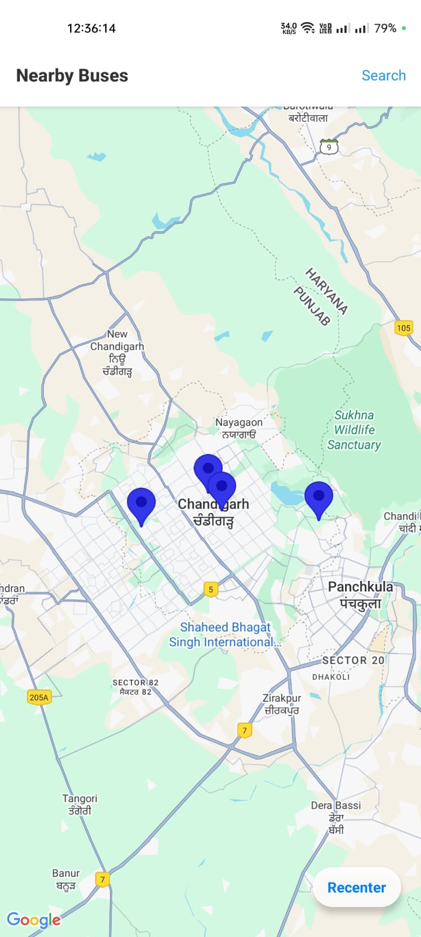
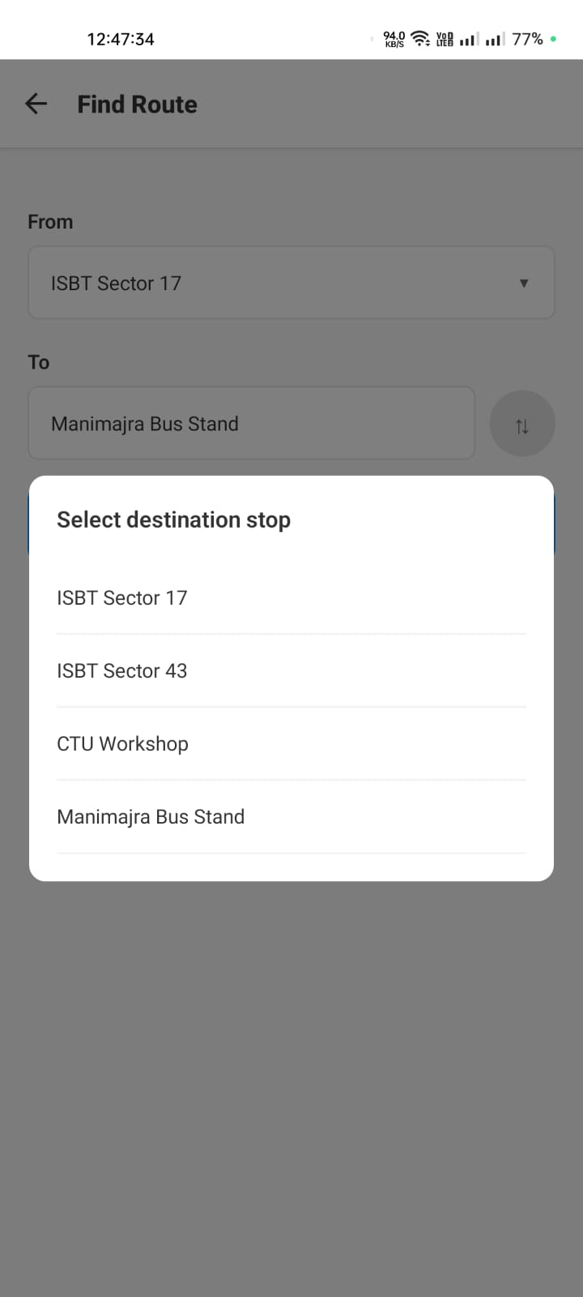
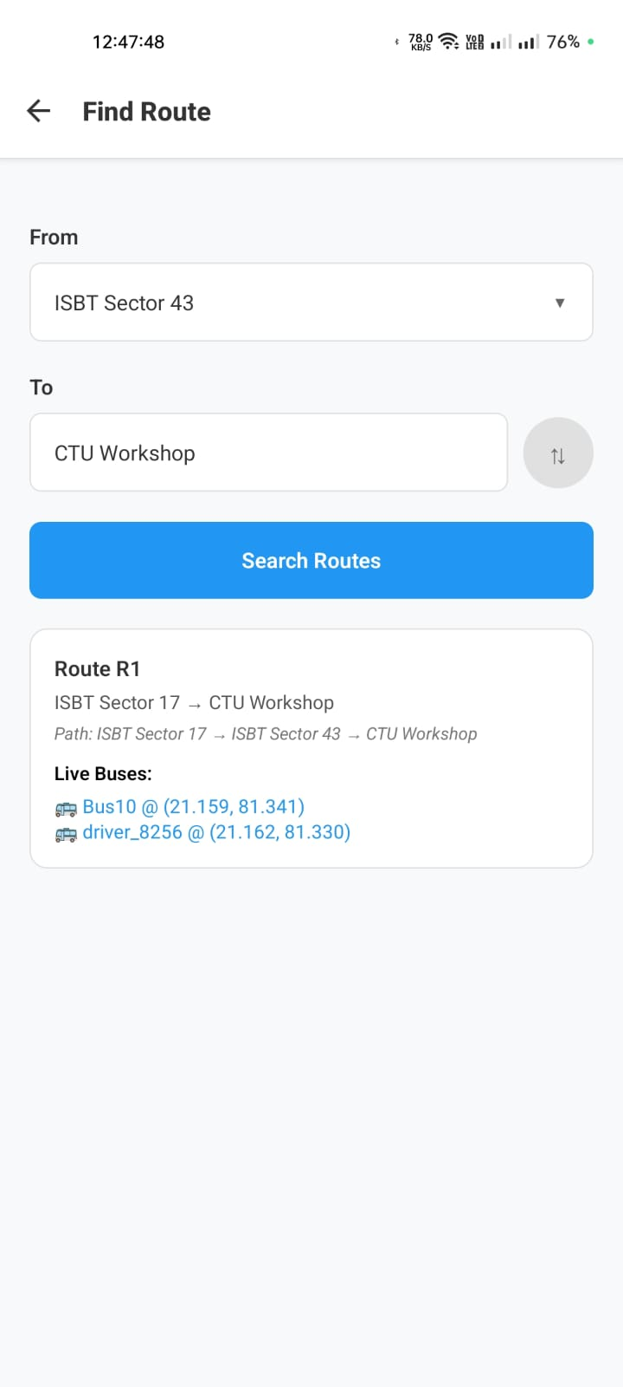
BusKr
APP INTERFACE: USER APP
HOME/MAP SCREEN with Bus Stop markers.
Pick-up and destination
selection in app.
Route display.
Key Features
Live ETA –
Real-time bus arrival times
Smart Alerts –
Delays, route changes
Alternate Routes –
Quick suggestions
Fav Stops –
One-tap tracking
“ Real-time routes, reliable rides—your bus at a glance.”

Slide 4
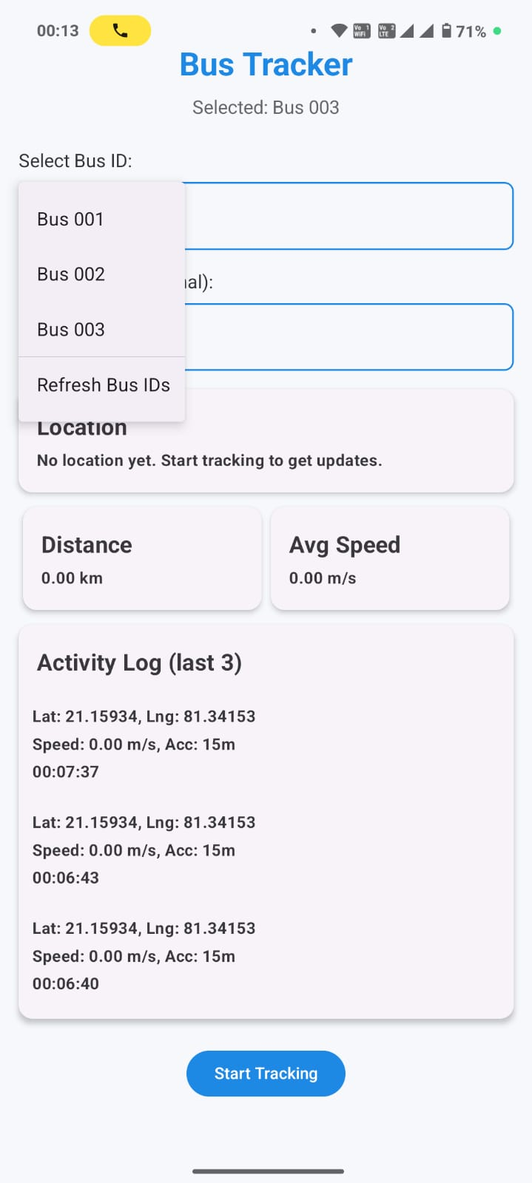
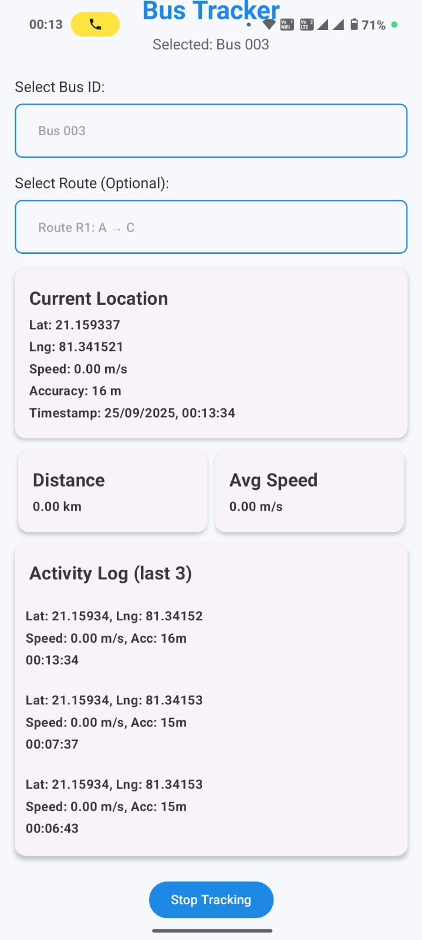
APP INTERFACE: DRIVER APP
BusKr
Bus and Route selection.
Tracking started.
Driver App Features
Quick Bus ID & Route Selection – Minimal input needed so drivers can start quickly.
Automatic GPS Tracking – Location updates sent every few seconds.
Activity Log – Recent location history for accuracy and route validation.
Low Data & Battery Use – Optimized for basic smartphones
Government Benefits
Real-Time Monitoring – Admin dashboard receives instant bus locations from the Driver App.
Fleet Analytics – Average speed, delays, and stoppages analyzed automatically.
Service Reliability – Detect late-running buses and optimize schedules.
Fuel & Cost Efficiency – Insights reduce idle time and prevent unnecessary detours.
Scalability – Easily expand to 100+ buses without new hardware.
“The Driver App is the backbone of our ecosystem,
simple for drivers, powerful for government monitoring”

Slide 5
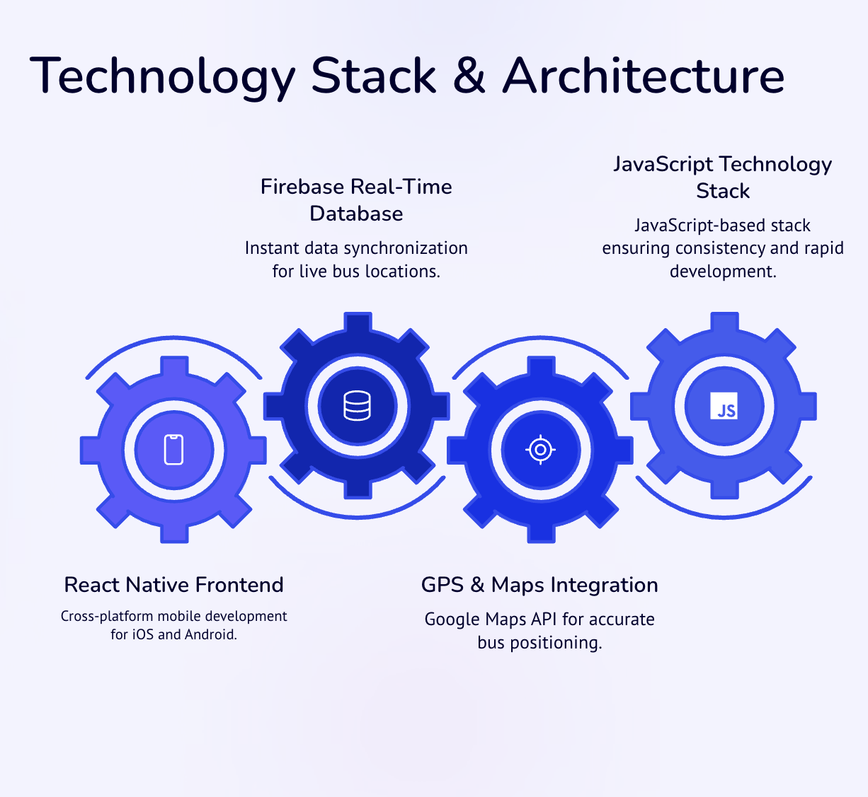
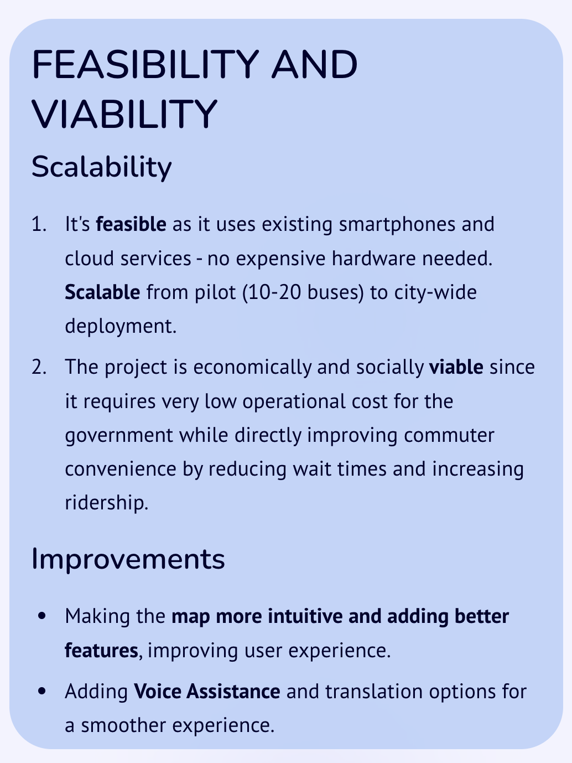
BusKr

Slide 6
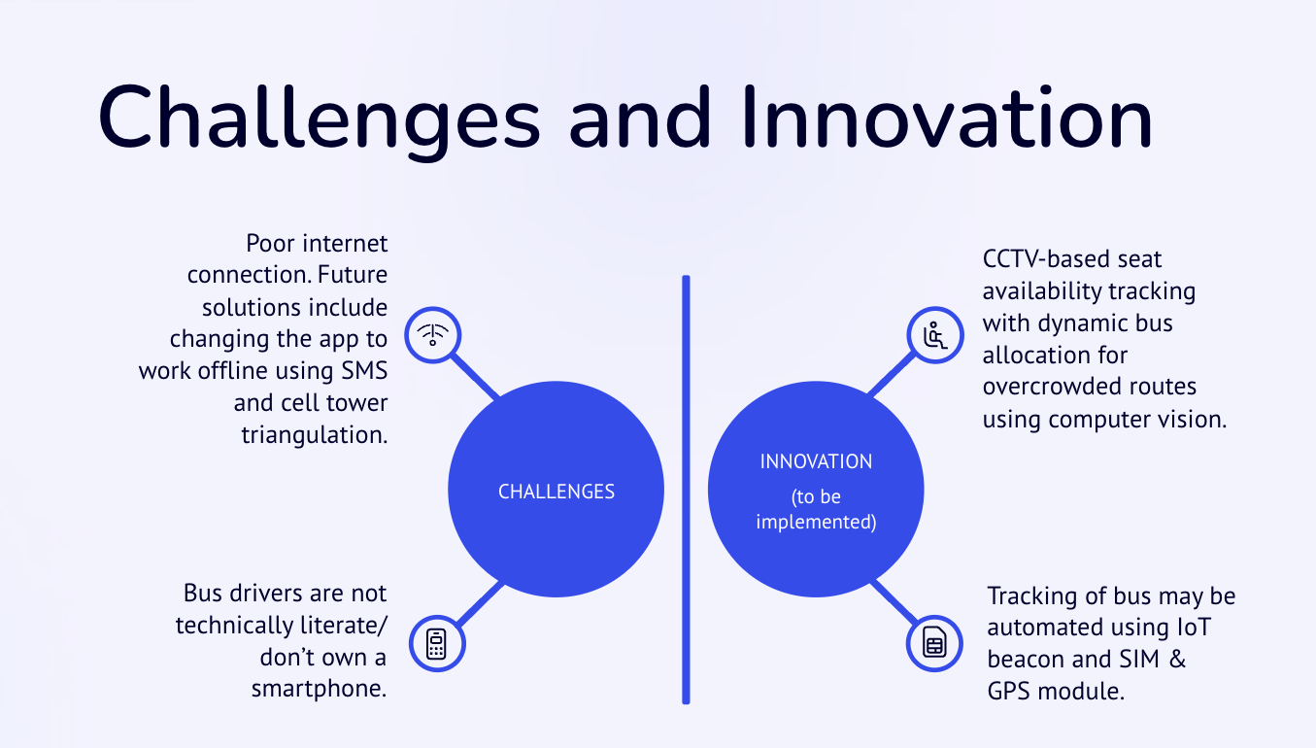
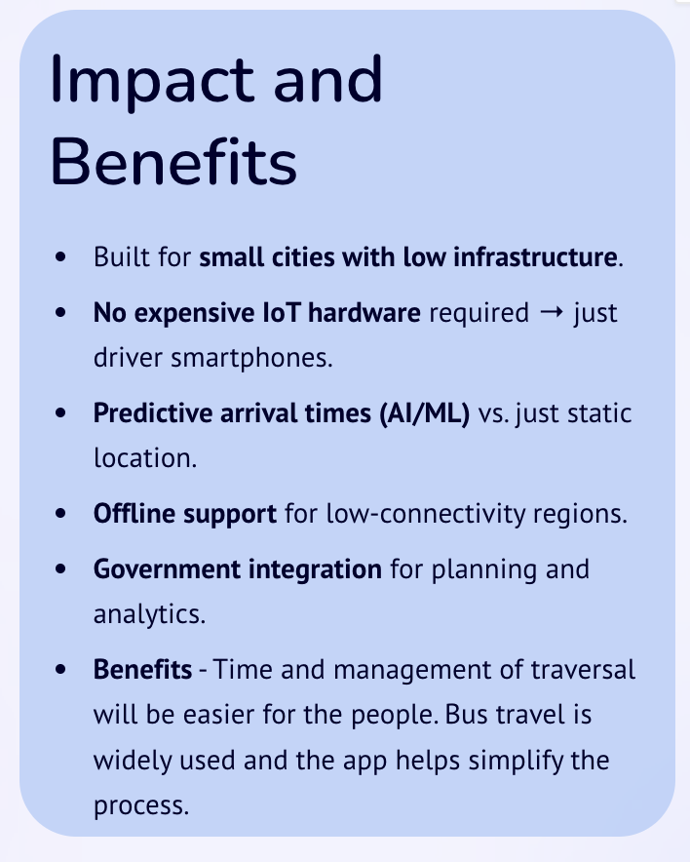
BusKr
Resources and References
NITI Aayog, Transforming Mobility in Tier-2 Cities, 2022. https://rmi.org/wp-content/uploads/2018/12/rmi-transforming-mobility-in-indian-cities.pdf
Ministry of Housing and Urban Affairs (MoHUA), Urban Mobility Report 2021. https://wri-india.org/sites/default/files/Urban%20Transport_Policy%20Note%20Series.pdf
World Bank, Urban Transport Sector Review: India, 2021. https://www.wri.org/insights/real-time-transit-data-good-people-and-cities-whats-holding-technology-back

